Slide 1
OTT Viewer Drop-off & Retention Analysis
Understanding Content, Behavior, and Platform Drivers of Viewer
(Winter Consulting Capstone Case | 2025)
Prepared by:
Adarsh Kumar
Tools Used:
Excel | SQL | Power BI | PowerPoint
Dataset:
OTT Episode-Level Viewer Retention Dataset

Slide 2
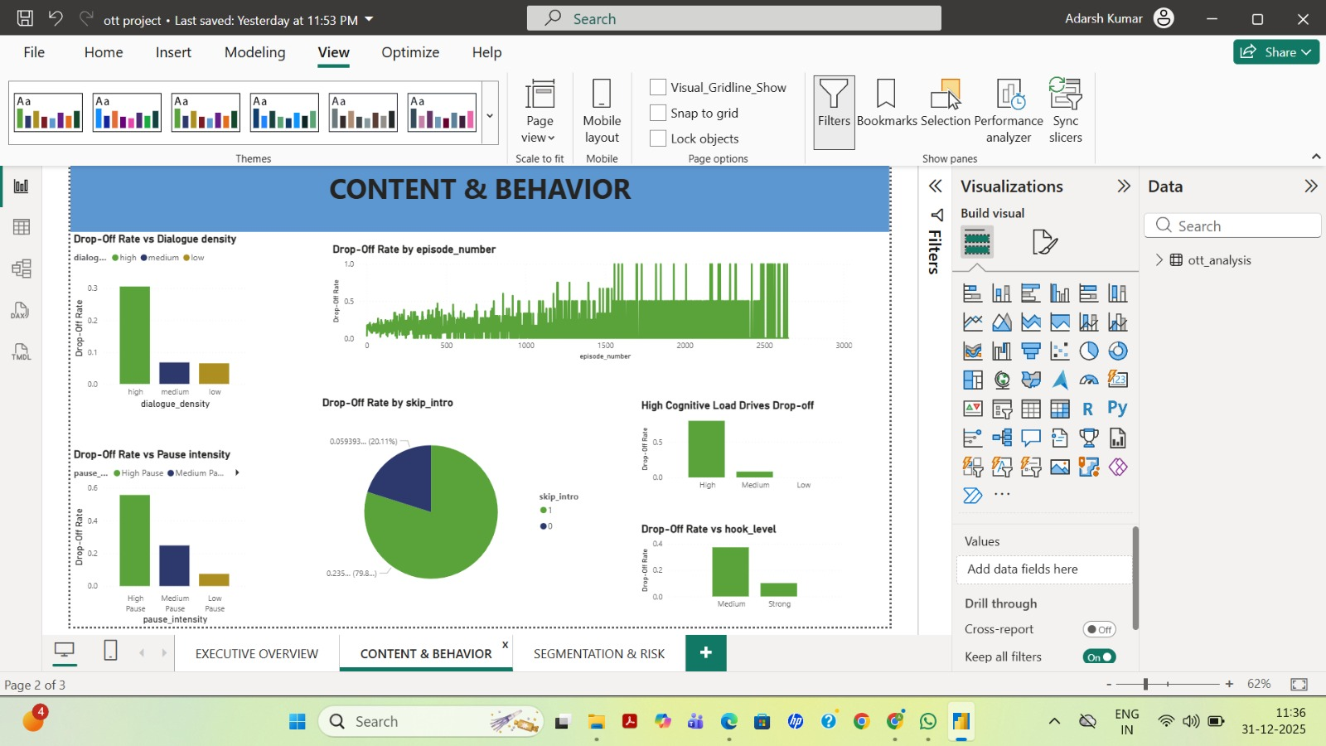
DATA-DRIVEN INSIGHTS WHICH TELLS( WHY DO VIEWERS DROP OFF?)
High cognitive load → ~45–50% drop-off
Weak/medium hooks → ~35–40% drop-off
High dialogue density → ~30% drop-off
High pause intensity → ~55–60% drop-off
~80% of drop-offs occur when intro is skipped
Conclusion:
Viewer drop-off is primarily driven by early cognitive overload and weak episode hooks, which significantly increase
disengagement, especially in the first few episodes.Behavioral signals such as high pause intensity and skip-intro actions
further amplify drop-off risk, while performance varies widely across platforms, indicating opportunities for
platform-specific optimization.

Slide 3
WHICH FACTOR HAS THE GREATEST IMPACT ON DROP-OFF RISK?
1. Pause Intensity (STRONGEST DRIVER)
High Pause Intensity: ~55–60% drop-off
Medium Pause Intensity: ~25%
Low Pause Intensity: <10%
This is the highest drop-off observed across all factors
Indicates confusion, overload, or disengagement
2. Cognitive Load (Strong Structural Driver)
High Cognitive Load: ~45–50% drop-off
Medium Cognitive Load: ~10–12%
Low Cognitive Load: ~5–7%
High mental effort significantly increases drop-off risk
Conclusion
High Pause Intensity is the single strongest indicator of drop-off risk, followed by high cognitive load.

Slide 4
What changes can be made, at the content or product level to reduce drop-off without compromising creative quality?
Content-Level Changes
Lower cognitive load in early episodes (Ep 1–3)
  Dashboard shows ~45–50% drop-off for high cognitive load episodes
  Compared to ~5–7% drop-off for low cognitive load
  Change: Gradual narrative build-up instead of front-loading complexity
Strengthen opening hooks
  Weak / Medium hook episodes show ~35–40% drop-off
  Strong hook episodes reduce drop-off to ~10–12%
  Change: Improve pacing and engagement in first few minutes, not story dilution
Reduce dialogue-heavy exposition
  High dialogue density episodes show ~30% drop-off
  Low dialogue density episodes show only ~6–7% drop-off
  Change: Support dialogue with visual cues instead of removing content
Use pause & rewind spikes as real-time risk signals
High pause intensity correlates with ~55–60% drop-off (strongest signal)
Action: Trigger contextual cues (recaps, character reminders, subtle hints)
Provide optional viewer assistance for complex content
  Action: On-demand summaries, relationship maps, or episode recaps
  Preserves creative depth while reducing viewer fatigue

Slide 5
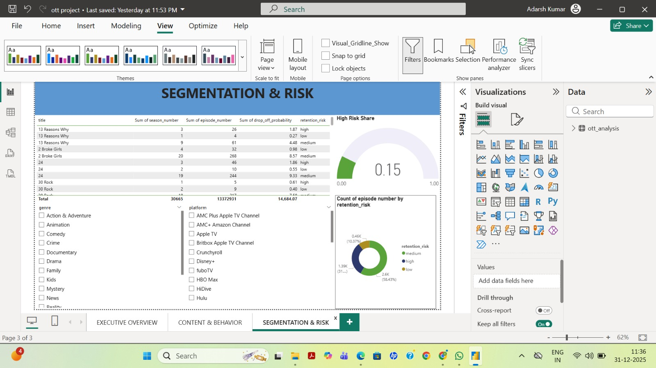
SEGMENTATION & RISK
Retention Risk Segmentation
High-risk episodes: ~31%
Medium-risk episodes: ~58%
Low-risk episodes: ~10%
Platform Segmentation
Worst platforms: ~20–21% drop-off
Best platforms: ~4–6% drop-off
15–17 pp performance gap
Insight:
A small subset of content and platforms drives a disproportionate share of churn.

Slide 6
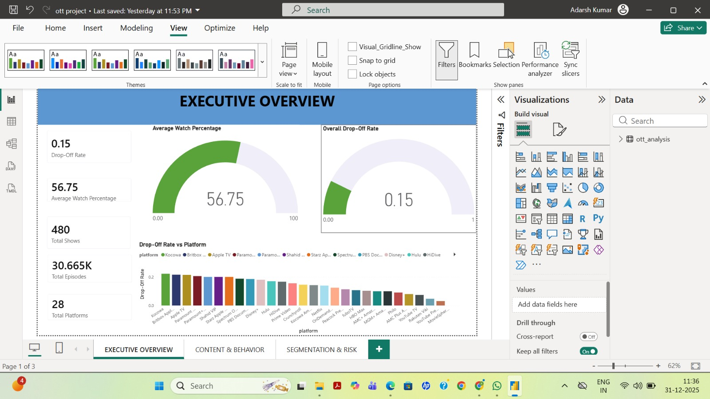
CONCLUSIONS
What Do We Conclude?
Drop-off is systematic, not random
Early episodes matter most
Behavioral signals (pause, skip) act as early warnings
Cognitive complexity without strong hooks is the biggest risk
CONCLUSION:
Analysis indicates that viewer drop-off is most sensitive to design choices in early episodes.
Episodes with high cognitive load and weaker hooks show significantly higher drop-off rates.
This suggests viewers disengage before forming narrative or emotional attachment.
Optimizing early-episode pacing and clarity materially improves retention metrics.
Importantly, these adjustments improve accessibility without reducing creative complexity later in the series.

Slide 7
RECOMMENDED ACTIONS & PRIORITIZATION
What should OTT platforms do first?
High Priority (Immediate Impact)
Reduce cognitive load in Episode 1–3
Strengthen hooks in the first 5 minutes
Flag episodes with high pause intensity in real time
Medium Priority
Add contextual recaps / character summaries
Optimize dialogue-heavy episodes with visual support
Lower Priority
Long-term platform-specific content optimization
Fine-tune genre-platform alignment
Impact Estimate
Potential drop-off reduction: 30+ percentage points for high-risk episodes

Slide 8
RISKS & CONSIDERATIONS
What could go wrong? How to manage it?
Key Risks
Over-simplifying content may impact creative quality
One-size-fits-all optimization may not suit all genres
Behavioral signals can be noisy without context
Mitigations
Apply changes only to high-risk segments
Pilot interventions before full rollout
Combine behavioral signals with content context
Final Note
Data-driven optimization should support creativity, not replace it

Slide 9
APPENDIX — DATA, METHODOLOGY & DEFINITIONS
1. DATA OVERVIEW
Total Episodes: ~30,665
Total Shows: 480
Total Platforms: 28
Granularity: Episode-level
Region: OTT platforms
2. KEY METRICS DEFINITIONS
Drop-off Rate: Probability of viewers exiting before episode completion
Average Watch %: Mean percentage of episode duration watched
Pause Intensity: Frequency of pause/rewind actions during playback
Retention Risk: Episode-level classification (Low / Medium / High) based on drop-off probability
3. ANALYTICAL APPROACH
SQL&Excel: Data cleaning, aggregation, feature grouping
Power BI: KPI tracking, segmentation, dashboard visualization
Analysis Levels: Episode | Genre | Platform | Risk segment
4. KEY ASSUMPTIONS & LIMITATIONS
No user-level demographics available
Observational data (no controlled experiments)
Behavioral signals interpreted as engagement proxies

